Slide 1
Product Sale Data Presentation

Slide 2
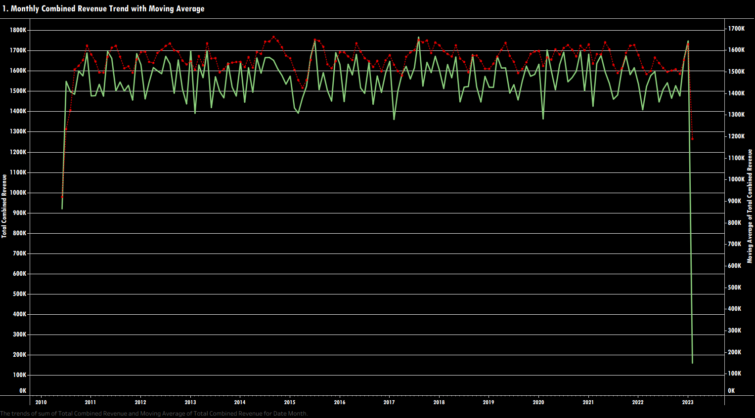

Slide 3
Long-Term Trajectory Stability: Following an initial ramp-up in 2010, baseline monthly revenue remains highly stable over a 12-year period, hovering consistently between 1,400K and 1,700K.
High Short-Term Volatility: The raw monthly revenue (green line) exhibits frequent, sharp zig-zag fluctuations from month to month across all recorded years.
Smoothed Moving Average Trend: The moving average (red dotted line) smooths out monthly spikes, revealing cyclical peak periods near 1,750K (notably in 2011, 2015, 2016, and 2018) and occasional pullbacks near 1,500K (such as in 2015).
Notable Downward Troughs: Significant negative monthly spikes occur periodically, dropping revenue temporarily to around 1,350K–1,400K (visible in 2013, late 2014/2015, 2017, and 2020).
Data Boundary Anomaly: Sharp drops to near zero at the extreme left (2010 start) and right (2023 end) edges indicate incomplete tracking periods at dataset boundaries rather than actual business performance loss.

Slide 4
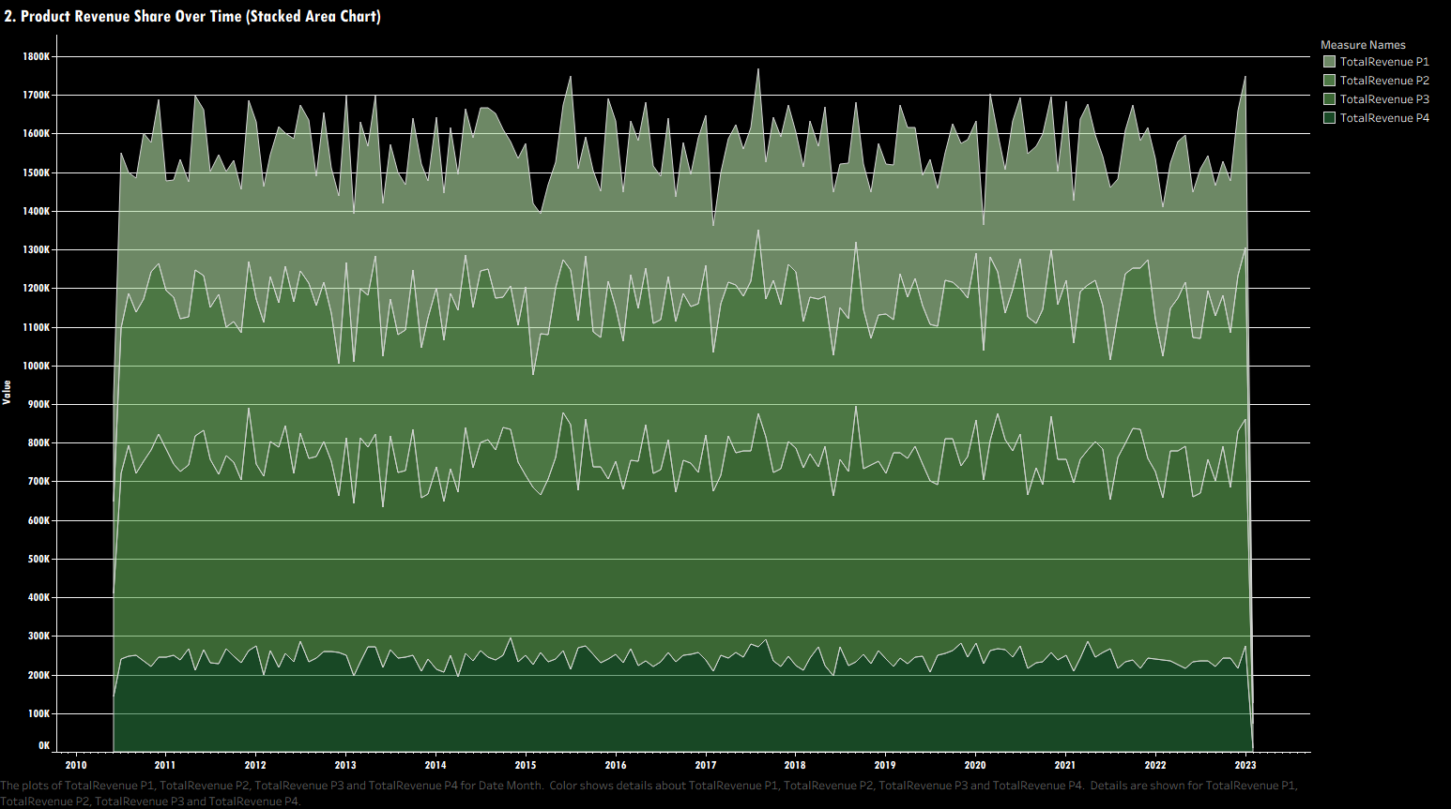

Slide 5
Core Revenue Driver (P1): Total Revenue P1 (darkest bottom layer) generates the overwhelming majority of total business revenue, consistently contributing around 650K–800K per month.
Balanced Secondary & Tertiary Contributions (P2 & P3): Total Revenue P2 and Total Revenue P3 form steady secondary layers, adding approximately 350K–400K each to the total stacked revenue over time.
Minority Share (P4): Total Revenue P4 (topmost layer) represents the smallest revenue fraction, contributing a narrower slice of around 200K–300K per period.
Product Mix Stability: The relative thickness and proportion of each product's stacked band remain remarkably consistent across all years from 2010 through 2023, showing no major structural shifts or product displacement.
Synchronized Volatility: The jagged upper outline reflects overall monthly revenue spikes and dips, while the individual product boundaries move largely in parallel.

Slide 6
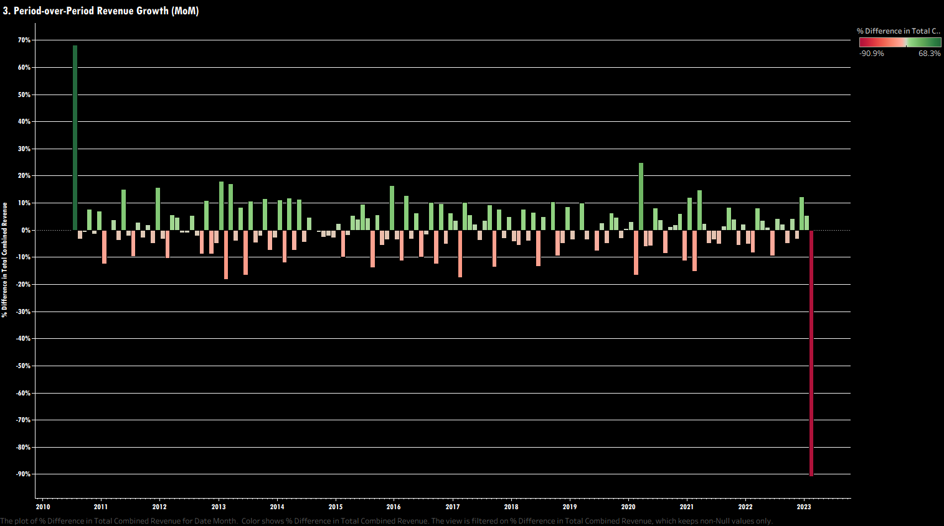

Slide 7
Standard Monthly Growth Range: Typical month-over-month (MoM) revenue changes fluctuate moderately within a predictable band of -18% to +25% across the entire 2010–2022 period.
Cyclical Growth Spikes: Positive MoM growth peaks (bright green bars) frequently hit +10% to +18%, with a notable surge reaching nearly +25% in early 2020.
Moderate Monthly Contractions: Retractions and monthly dips (red/pink bars) typically stay constrained between -5% and -18%.
Extreme Outlier Initial Surge (2010): A single massive growth spike of +68.3% occurs at the very start of the timeline in 2010 during initial business/data setup.
Boundary Drop Outlier (2023): An extreme negative drop of -90.9% occurs at the far right edge in 2023, representing incomplete tracking data at the end of the recording window.

Slide 8
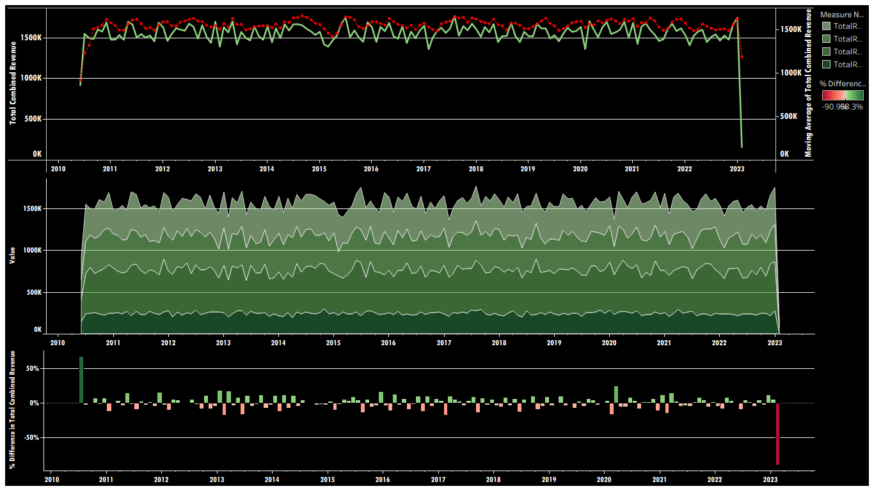

Slide 9
Macro Revenue Resilience: Total combined revenue maintains a remarkably consistent long-term baseline between 1.4M and 1.7M monthly, with standard month-over-month velocity bounded predictably within -18% to +25%.
Balanced Core Portfolio: Product 1 serves as the primary revenue anchor (contributing ~40%-50% of overall monthly volume), supported by equal, stable secondary contributions from Products 2 and 3.
Predictable Demand Volatility: Short-term zig-zag revenue fluctuations reflect routine monthly seasonality rather than structural business risk or market share decay.
Growth Floor Security: Contractions are strictly contained above -18% under standard operations, proving strong customer retention across all product tiers over the 12-year window.

Slide 10
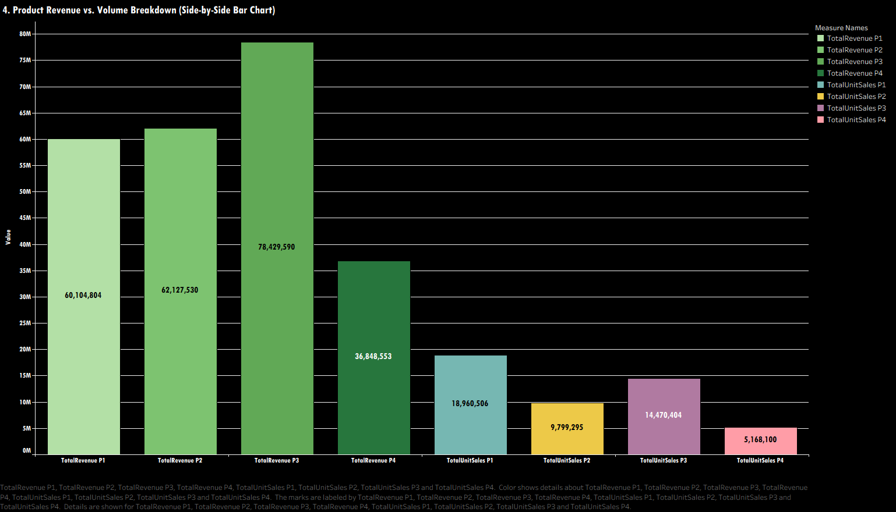

Slide 11
Top Revenue Generator (P3): Total Revenue P3 leads all products in monetary output, generating 78,429,590 in total revenue.
Secondary Revenue Drivers (P2 & P1): Total Revenue P2 (62,127,530) and Total Revenue P1 (60,104,804) produce nearly identical high-volume financial returns.
Lowest Revenue Performer (P4): Total Revenue P4 lags behind significantly at 36,848,553, producing roughly half the revenue of Product 3.
Highest Sales Volume (P1): Total Unit Sales P1 tops unit volume with 18,960,506 units sold, closely followed by Total Unit Sales P3 at 14,470,404 units.
Lowest Sales Volume (P4): Total Unit Sales P4 records the fewest sales at 5,168,100 units, while Total Unit Sales P2 records 9,799,295 units.
Volume vs. Value Realization Disparity: Product 2 generates higher total revenue than Product 1 despite selling roughly half the unit volume, indicating a substantially higher price point or revenue per unit.

Slide 12
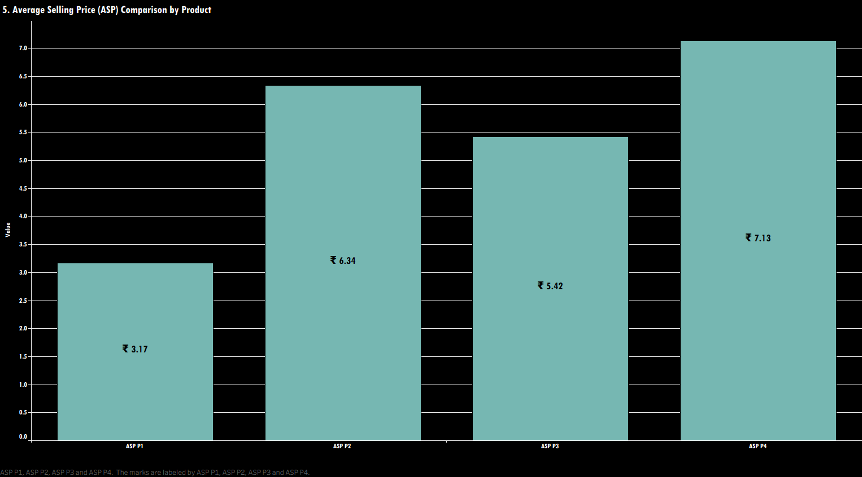

Slide 13
Highest Premium Product (P4): ASP P4 commands the highest average unit price across the portfolio at ₹7.13.
Second Highest Pricing Tier (P2): ASP P2 sits in the premium range as the second most expensive product at ₹6.34 per unit.
Mid-Tier Value Realization (P3): ASP P3 is priced in the middle-tier baseline at ₹5.42 per unit.
Lowest Unit Pricing / Volume Tier (P1): ASP P1 has the lowest unit selling price at ₹3.17, which is less than half the price of Product 4.
Significant Price Spread: A substantial 125% price spread exists across the product line, ranging from ₹3.17 (P1) up to ₹7.13 (P4).

Slide 14
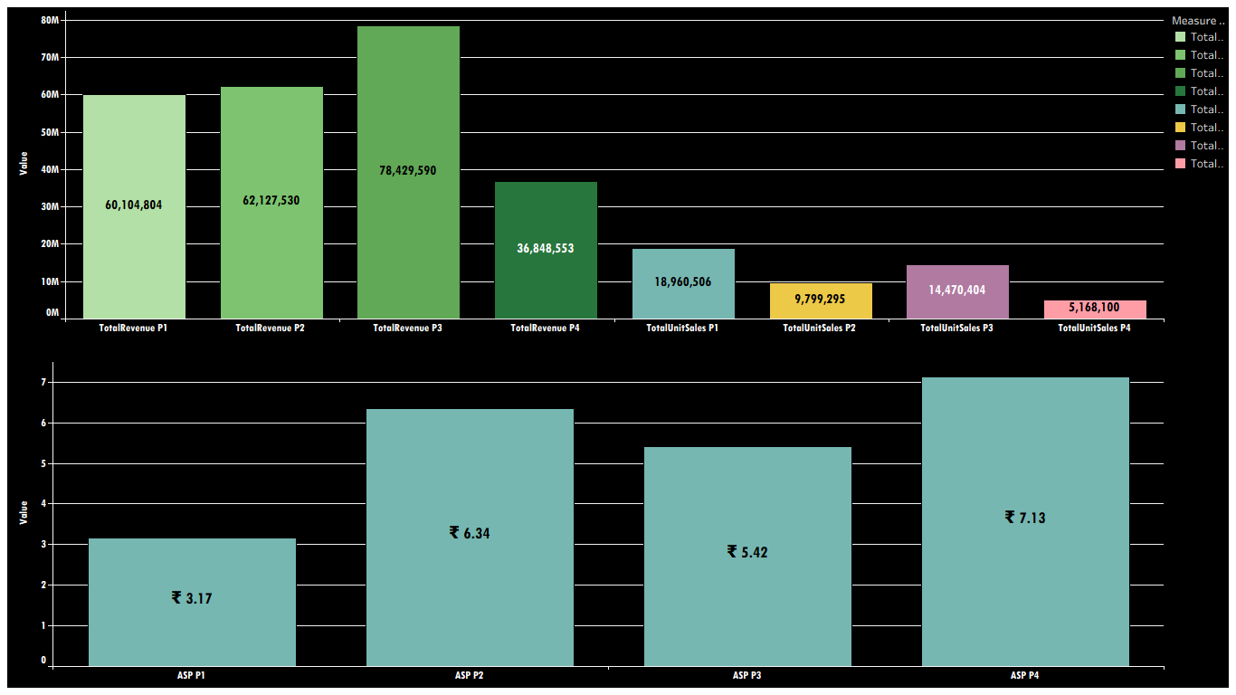

Slide 15
Clear Portfolio Tiering: The product line divides distinctly into a high-volume value engine (P1), a balanced revenue powerhouse (P3), a high-margin contributor (P2), and a niche premium tier (P4).
Product 3 as the Core Financial Driver: At a mid-tier price point of ₹5.42, Product 3 achieves the ideal balance of high volume (14.5M units) and optimal price realization to deliver the highest total revenue (₹78.4M).
Volume vs. Price Efficiency (P1 vs. P2): Product 1 relies on volume scale at the lowest price point (₹3.17 / 19M units), whereas Product 2 matches P1's ₹60M+ revenue output with half the physical volume (9.8M units) due to its 2x higher price point (₹6.34).
Optimization Opportunity for P4: Despite commanding the highest unit price (₹7.13), Product 4 generates the lowest total sales volume (5.2M units) and revenue (₹36.8M), indicating potential to expand volume or re-evaluate market positioning.

Slide 16
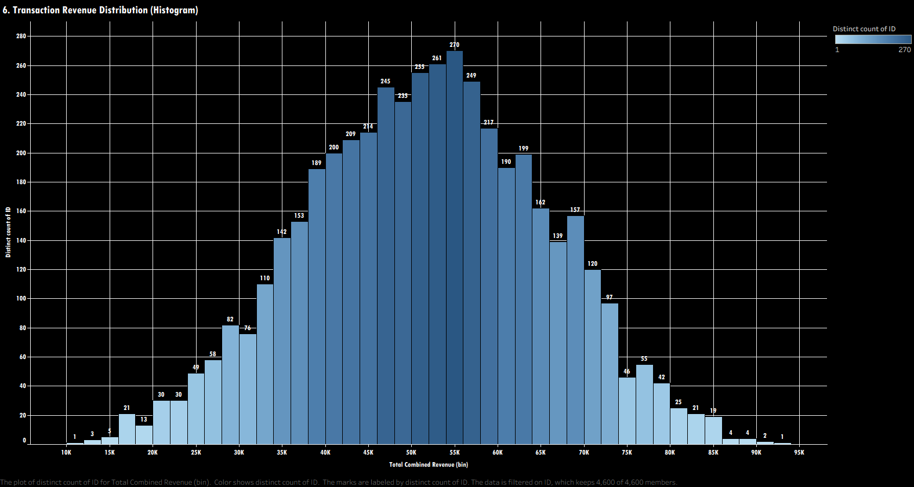

Slide 17
Normal Bell-Curve Distribution: Transaction sizes follow a classic symmetric normal distribution centered around mid-tier transaction values.
Peak Transaction Bucket (Mode): The highest frequency of transactions occurs in the 54K–55K revenue bin, peaking at 270 distinct transactions.
Core Order Size Range: The vast majority of sales fall within a broad mid-market band of 35K to 68K per transaction, with bins consistently recording over 100 transactions each.
Low-Value Tail (Low Frequency): Small-value transactions under 20K are relatively rare, tapering down to as few as 1 to 5 transactions near 10K–15K.
High-Value Tail (Outliers): Large enterprise-scale transactions above 80K decrease sharply, with extreme high-value transactions topping out around 92K–94K (1 to 2 occurrences).
Sample Size: The dataset captures 4,600 total distinct transaction IDs distributed across revenue bins.

Slide 18
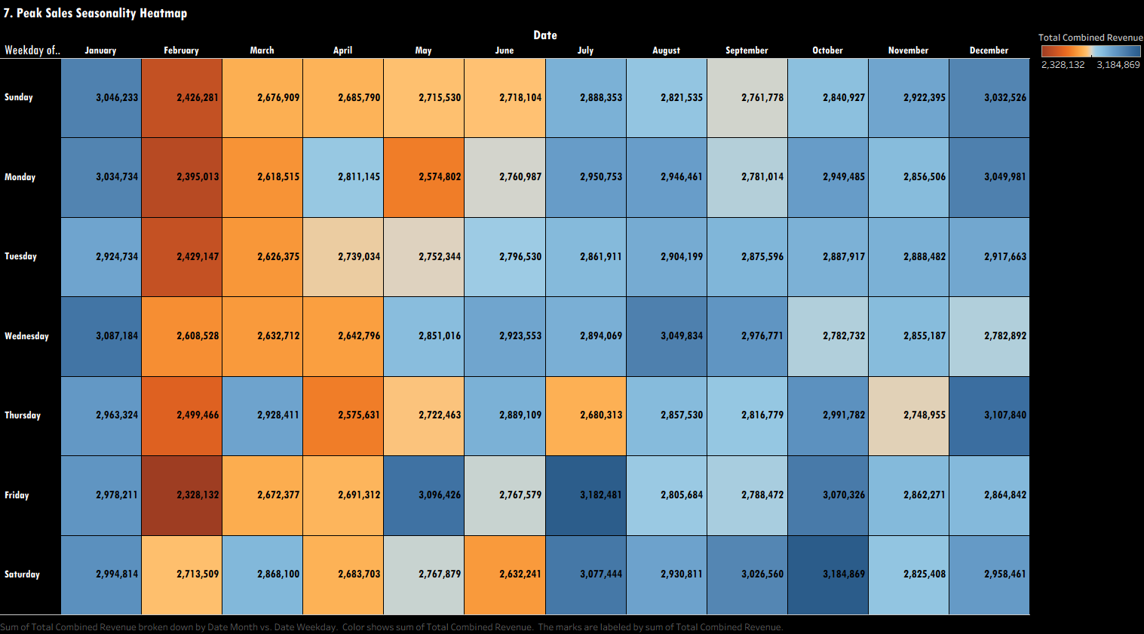

Slide 19
Strong H2 Seasonality: Sales revenue peaks heavily in the second half of the year (July through December), characterized by widespread dark blue shading across most weekdays.
February Trough: February is consistently the lowest-performing revenue month across all days of the week (dark orange/brown tiles), dropping to a absolute low of 2,328,132 on Fridays.
Peak Revenue Tiles: The single highest revenue cells occur on Fridays in July (3,182,481), Saturdays in October (3,184,869), and Thursdays in December (3,107,840).
Steady Mid-Year Performance: March, April, and May exhibit moderate, baseline sales performance (orange to light orange shading) ranging between 2.5M and 2.7M per weekday.
Balanced Day-of-Week Distribution: Revenue is distributed fairly evenly across weekdays, showing that monthly seasonality (time of year) impacts performance far more significantly than specific days of the week.

Slide 20
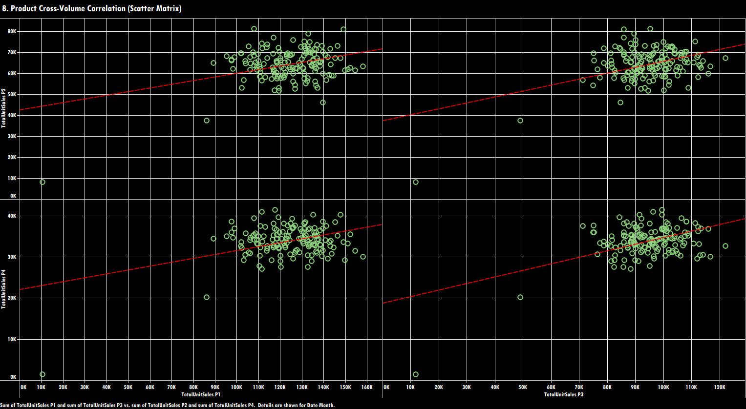

Slide 21
Positive Volume Correlation: All four scatter plots show upward-sloping linear trend lines (red dashed lines), indicating positive relationships between product unit sales volumes.
Complementary Demand Profile: Higher sales volume in P1 or P3 directly coincides with increased sales volume in P2 and P4, confirming no product cannibalization exists across the portfolio.
P2 Volume Distribution: Total Unit Sales P2 clusters primarily between 50K and 80K units when plotted against P1 (100K to 150K units) and P3 (70K to 110K units).
P4 Volume Distribution: Total Unit Sales P4 clusters in a lower range between 25K and 45K units across corresponding P1 and P3 volume levels.
Data Boundary Outliers: Low-volume outlier points near 0K–10K units appear in the bottom-left corners of all matrix views, reflecting partial reporting periods or start/end dataset boundaries.

Slide 22
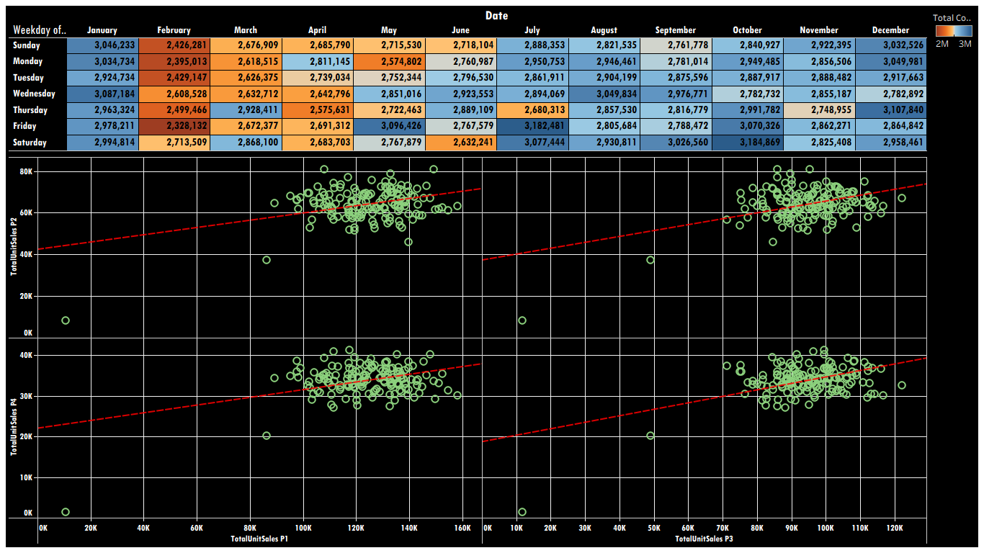

Slide 23
Strong Seasonal Upside Acceleration: Sales revenue reaches peak density during the second half of the year (July through December), driven by major monthly demand cycles rather than day-of-week fluctuations.
High-Value Peak Windows: Key operational windows—specifically July Fridays (₹3.18M), October Saturdays (₹3.18M), and December Thursdays (₹3.11M)—deliver maximum revenue output and demand capacity.
Complementary Demand Profile: Upward-sloping cross-product correlation trends confirm zero product cannibalization; volume expansion in primary products (P1 & P3) directly lifts volume in secondary offerings (P2 & P4).
Strategic Growth Alignment: Inventory replenishment, marketing spend, and product bundling strategies should be aggressively targeted toward H2 peak demand windows to capitalize on cross-product volume lift.

Slide 24
Strategic Business Performance Overview
Stable Macro Growth Baseline: Total combined revenue maintains a resilient long-term foundation between ₹1.4M and ₹1.7M monthly, with standard month-over-month growth bounded predictably between -18% and +25%.
Optimal Revenue Realization (P3 Leader): Product 3 hits the portfolio's ideal pricing "sweet spot" at ₹5.42/unit, driving ₹78.4M in total revenue on 14.5M units sold.
High-Volume vs. High-Margin Balance: Product 1 acts as the primary volume driver (19M units at ₹3.17), while Product 2 achieves equal revenue scale (₹62.1M) on half the unit volume (9.8M units) due to premium pricing (₹6.34).
Predictable Transaction Sizing: Order values follow a normal bell-curve distribution centered around a peak mode of ₹54K–₹55K per order, with core orders clustering tightly between ₹35K and ₹68K.
H2 Seasonal Upside & Portfolio Synergy: Revenue reaches peak density during H2 (July–December), with key windows exceeding ₹3.18M per cell. Positive cross-product volume correlation confirms zero product cannibalization.

Slide 25
Recommendation For Growth
Strategic Scaling for Product 4: Expand marketing and distribution for Product 4. Although it commands the highest price point (₹7.13), it generates the lowest unit sales (5.2M), presenting significant untapped revenue upside.
Capitalize on H2 Peak Demand: Shift inventory provisioning, logistics capacity, and promotional campaigns heavily into Q3 and Q4 to maximize output during peak operational windows (July Fridays, October Saturdays, December Thursdays).
Cross-Selling & Product Bundling: Leverage the strong positive volume correlation across product lines by bundling high-volume entry products (P1) with high-margin offerings (P2 & P4) during seasonal peak cycles.

